Slide 1
Projektni zadatak iz predmeta Termodinamika sa termotehnikom

Slide 2
Za čvrsto gorivo sledećeg procentualnog sastava:
Izračunati donju toplotnu moć goriva (H_{d}) pomoću VDI formule.
Odrediti minimalnu količinu vazduha (L_{min}) potrebnog za sagorevanje datog goriva (N=79% i O=21%).
Izračunati zapreminu vlažnih i suvih produkata sagorevanja i konstruisati V_{x} - λ dijagram uzimajući: λ = 1,0 ... 1,5 ... 2,0; sa korakom od 0,1.
Izračunati procentualni sastav produkata sagorevanja i nacrtati r_{x} - λ dijagram za vrednosti: λ = 1,0 ... 1,5 ... 2,0, sa korakom od 0,1.
Nacrtati i-ti dijagram produkata sagorevanja za vrednosti λ = 1,0 ... 1,5 ... 2,0, uz promenu temperature od 100°C do 2000°C sa korakom od 100°C.
C | H | O | N | S | A | W
38,12 | 3,03 | 15,00 | 0,79 | 0,2 | 5,86 | 37,00

Slide 3
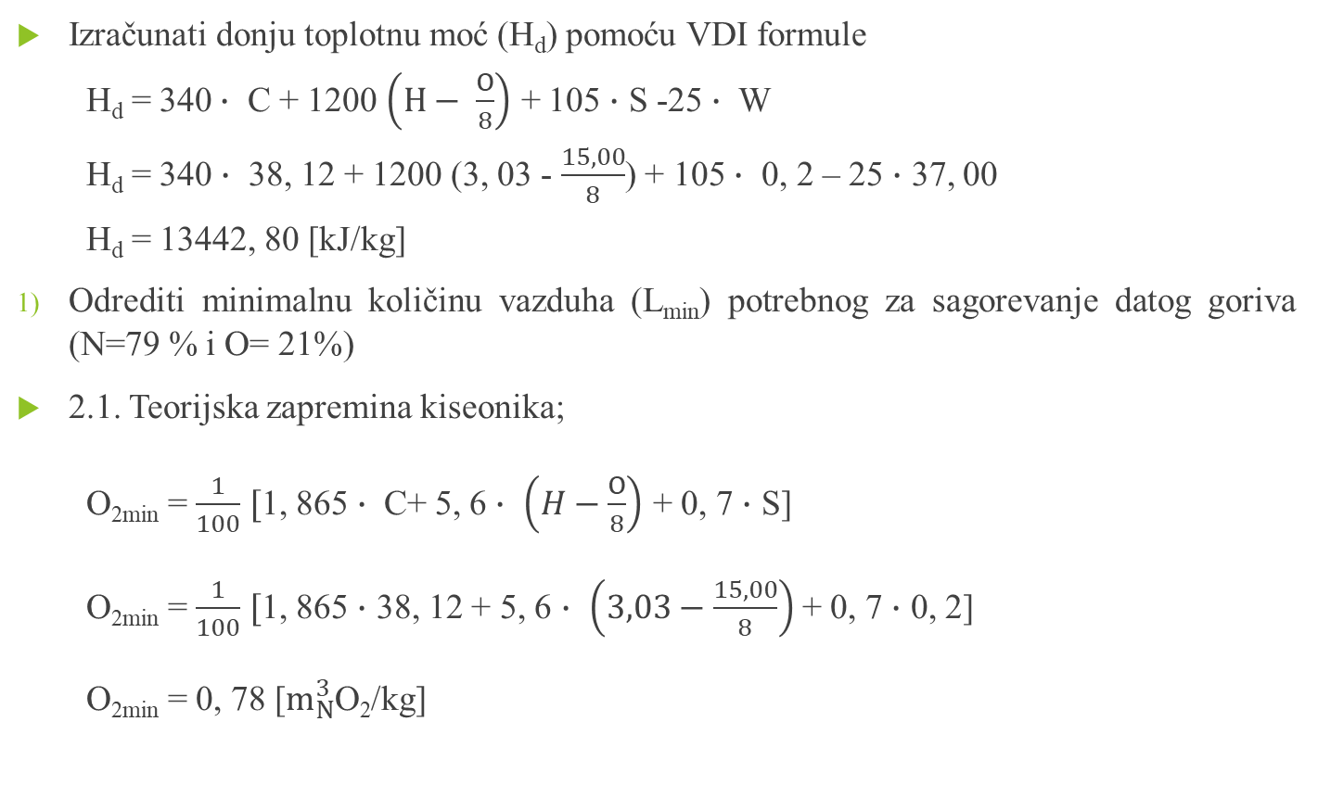
Izračunati donju toplotnu moć (H_{d}) pomoću VDI formule
H_{d} = 340$∙$ C + 1200 $\left(H− \frac{O}{8}\right)$ + 105 $∙$ S -25 $∙$ W
H_{d} = 340 $∙$ 38, 12 + 1200 (3, 03 - $\frac{15,00}{8}$) + 105 $∙$ 0, 2 – 25 $∙$ 37, 00
H_{d} = 13442, 80 [kJ/kg]
Odrediti minimalnu količinu vazduha (L_{min}) potrebnog za sagorevanje datog goriva (N=79 % i O= 21%)
2.1. Teorijska zapremina kiseonika;
O_{2min} = $\frac{1}{100}$ $[$1, 865$∙$ C+ 5, 6 $∙$ $\left(H−\frac{O}{8}\right)$ + 0, 7 $∙$ S]
O_{2min} = $\frac{1}{100}$ $[$1, 865 $∙$ 38, 12 + 5, 6 $∙$ $\left(3,03−\frac{15,00}{8}\right)$ + 0, 7 $∙$ 0, 2]
O_{2min} = 0, 78 [$m_{N}^{3}$O₂/kg]

Slide 4
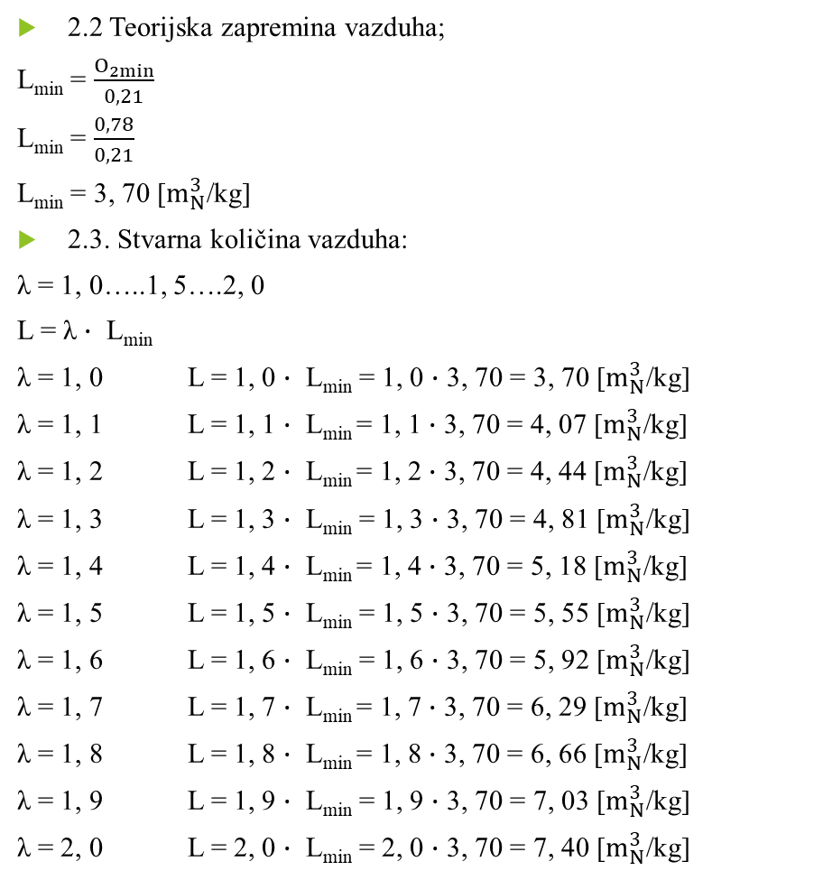
2.2 Teorijska zapremina vazduha;
L_{min} = $\frac{O_{2min}}{0,21}$
L_{min} = $\frac{0,78}{0,21}$
L_{min} = 3, 70 [$m_{N}^{3}$/kg]
2.3. Stvarna količina vazduha:
λ = 1, 0…..1, 5….2, 0
L = λ $∙$ L_{min}
λ = 1, 0 L = 1, 0 $∙$ L_{min} = 1, 0 $∙$ 3, 70 = 3, 70 [$m_{N}^{3}$/kg]
λ = 1, 1 L = 1, 1 $∙$ L_{min} = 1, 1 $∙$ 3, 70 = 4, 07 [$m_{N}^{3}$/kg]
λ = 1, 2 L = 1, 2 $∙$ L_{min} = 1, 2 $∙$ 3, 70 = 4, 44 [$m_{N}^{3}$/kg]
λ = 1, 3 L = 1, 3 $∙$ L_{min} = 1, 3 $∙$ 3, 70 = 4, 81 [$m_{N}^{3}$/kg]
λ = 1, 4 L = 1, 4 $∙$ L_{min} = 1, 4 $∙$ 3, 70 = 5, 18 [$m_{N}^{3}$/kg]
λ = 1, 5 L = 1, 5 $∙$ L_{min} = 1, 5 $∙$ 3, 70 = 5, 55 [$m_{N}^{3}$/kg]
λ = 1, 6 L = 1, 6 $∙$ L_{min} = 1, 6 $∙$ 3, 70 = 5, 92 [$m_{N}^{3}$/kg]
λ = 1, 7 L = 1, 7 $∙$ L_{min} = 1, 7 $∙$ 3, 70 = 6, 29 [$m_{N}^{3}$/kg]
λ = 1, 8 L = 1, 8 $∙$ L_{min} = 1, 8 $∙$ 3, 70 = 6, 66 [$m_{N}^{3}$/kg]
λ = 1, 9 L = 1, 9 $∙$ L_{min} = 1, 9 $∙$ 3, 70 = 7, 03 [$m_{N}^{3}$/kg]
λ = 2, 0 L = 2, 0 $∙$ L_{min} = 2, 0 $∙$ 3, 70 = 7, 40 [$m_{N}^{3}$/kg]

Slide 5

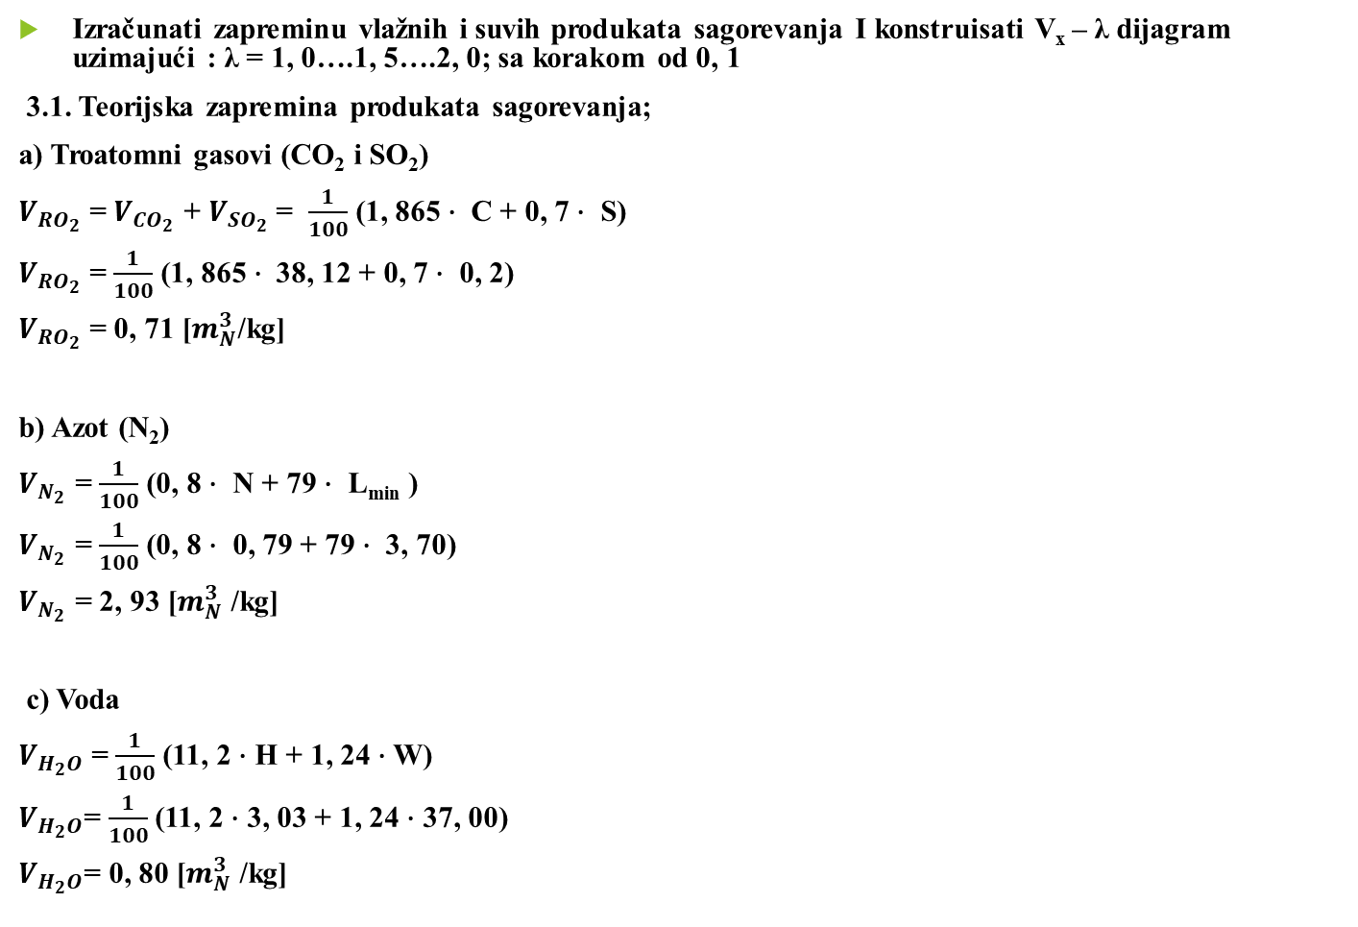
Izračunati zapreminu vlažnih i suvih produkata sagorevanja I konstruisati V_{x} – λ dijagram uzimajući : λ = 1, 0….1, 5….2, 0; sa korakom od 0, 1
3.1. Teorijska zapremina produkata sagorevanja;
a) Troatomni gasovi (CO₂ i SO₂)
$V_{{RO}_{2}}$ = $V_{{CO}_{2}}$ + $V_{{SO}_{2}}$ = $\frac{1}{100}$ (1, 865$∙$ C + 0, 7 $∙$ S)
$V_{{RO}_{2}}$ = $\frac{1}{100}$ (1, 865$∙$ 38, 12 + 0, 7 $∙$ 0, 2)
$V_{{RO}_{2}}$ = 0, 71 [$m_{N}^{3}$/kg]
b) Azot (N₂)
$V_{N_{2}}$ = $\frac{1}{100}$ (0, 8 $∙$ N + 79 $∙$ L_{min} )
$V_{N_{2}}$ = $\frac{1}{100}$ (0, 8 $∙$ 0, 79 + 79 $∙$ 3, 70)
$V_{N_{2}}$ = 2, 93 [$m_{N}^{3}$ /kg]
c) Voda
$V_{H_{2}O}$ = $\frac{1}{100}$ (11, 2 $∙$ H + 1, 24 $∙$ W)
$V_{H_{2}O}$= $\frac{1}{100}$ (11, 2 $∙$ 3, 03 + 1, 24 $∙$ 37, 00)
$V_{H_{2}O}$= 0, 80 [$m_{N}^{3}$ /kg]
d) Vazduh
λ = 1, 0…..1, 5….2, 0
V_{l} = (λ – 1) $∙$ L_{min}
λ = 1, 0 V_{l} = 1, 0 $∙$ L_{min} = (1, 0 – 1) $∙$ 3, 70 = 0, 00 [$m_{N}^{3}$ /kg]
λ = 1, 1 V_{l} = 1, 1 $∙$ L_{min} = (1, 1 – 1) $∙$ 3, 70 = 0, 37 [$m_{N}^{3}$ /kg]
λ = 1, 2 V_{l} = 1, 2 $∙$ L_{min} = (1, 2 – 1) $∙$ 3, 70 = 0, 74 [$m_{N}^{3}$ /kg]
λ = 1, 3 V_{l} = 1, 3 $∙$ L_{min} = (1, 3 – 1) $∙$ 3, 70 = 1, 11 [$m_{N}^{3}$ /kg]
λ = 1, 4 V_{l} = 1, 4 $∙$ L_{min} = (1, 4 – 1) $∙$ 3, 70 = 1, 48 [$m_{N}^{3}$ /kg]
λ = 1, 5 V_{l} = 1, 5 $∙$ L_{min} = (1, 5 – 1) $∙$ 3, 70 = 1, 85 [$m_{N}^{3}$ /kg]
λ = 1, 6 V_{l} = 1, 6 $∙$ L_{min} = (1, 6 – 1) $∙$ 3, 70 = 2, 22 [$m_{N}^{3}$ /kg]
λ = 1, 7 V_{l} = 1, 7 $∙$ L_{min} = (1, 7 – 1) $∙$ 3, 70 = 2, 59 [$m_{N}^{3}$ /kg]
λ = 1, 8 V_{l} = 1, 8 $∙$ L_{min} = (1, 8 - 1) $∙$ 3, 70 = 2, 96 [$m_{N}^{3}$ /kg]
λ = 1, 9 V_{l} = 1, 9 $∙$ L_{min} = (1, 9 – 1) $∙$ 3, 70 = 3, 33 [$m_{N}^{3}$ /kg]
λ = 2, 0 V_{l} = 2, 0 $∙$ L_{min} = (2, 0 – 1) $∙$ 3, 70 = 3, 70 [$m_{N}^{3}$ /kg]

Slide 6
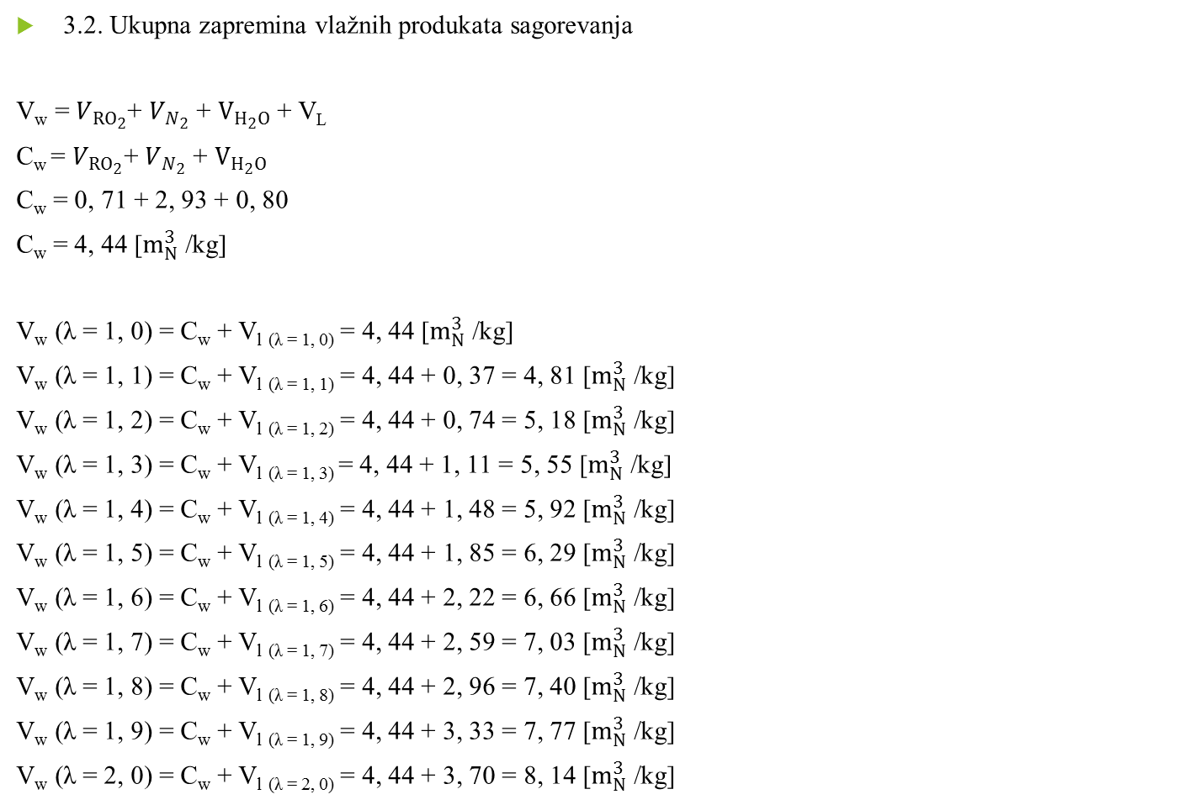
3.2. Ukupna zapremina vlažnih produkata sagorevanja
V_{w} = $V_{{RO}_{2}}$+ $V_{N_{2}}$ + $V_{H_{2}O}$ + V_{L}
C_{w} = $V_{{RO}_{2}}$+ $V_{N_{2}}$ + $V_{H_{2}O}$
C_{w} = 0, 71 + 2, 93 + 0, 80
C_{w} = 4, 44 [$m_{N}^{3}$ /kg]
V_{w} (λ = 1, 0) = C_{w} + V_{l} _{(λ = 1, 0)} = 4, 44 [$m_{N}^{3}$ /kg]
V_{w} (λ = 1, 1) = C_{w} + V_{l} _{(λ = 1, 1)} = 4, 44 + 0, 37 = 4, 81 [$m_{N}^{3}$ /kg]
V_{w} (λ = 1, 2) = C_{w} + V_{l} _{(λ = 1, 2)} = 4, 44 + 0, 74 = 5, 18 [$m_{N}^{3}$ /kg]
V_{w} (λ = 1, 3) = C_{w} + V_{l} _{(λ = 1, 3)} = 4, 44 + 1, 11 = 5, 55 [$m_{N}^{3}$ /kg]
V_{w} (λ = 1, 4) = C_{w} + V_{l} _{(λ = 1, 4)} = 4, 44 + 1, 48 = 5, 92 [$m_{N}^{3}$ /kg]
V_{w} (λ = 1, 5) = C_{w} + V_{l} _{(λ = 1, 5)} = 4, 44 + 1, 85 = 6, 29 [$m_{N}^{3}$ /kg]
V_{w} (λ = 1, 6) = C_{w} + V_{l} _{(λ = 1, 6)} = 4, 44 + 2, 22 = 6, 66 [$m_{N}^{3}$ /kg]
V_{w} (λ = 1, 7) = C_{w} + V_{l} _{(λ = 1, 7)} = 4, 44 + 2, 59 = 7, 03 [$m_{N}^{3}$ /kg]
V_{w} (λ = 1, 8) = C_{w} + V_{l} _{(λ = 1, 8)} = 4, 44 + 2, 96 = 7, 40 [$m_{N}^{3}$ /kg]
V_{w} (λ = 1, 9) = C_{w} + V_{l} _{(λ = 1, 9)} = 4, 44 + 3, 33 = 7, 77 [$m_{N}^{3}$ /kg]
V_{w} (λ = 2, 0) = C_{w} + V_{l} _{(λ = 2, 0)} = 4, 44 + 3, 70 = 8, 14 [$m_{N}^{3}$ /kg]

Slide 7
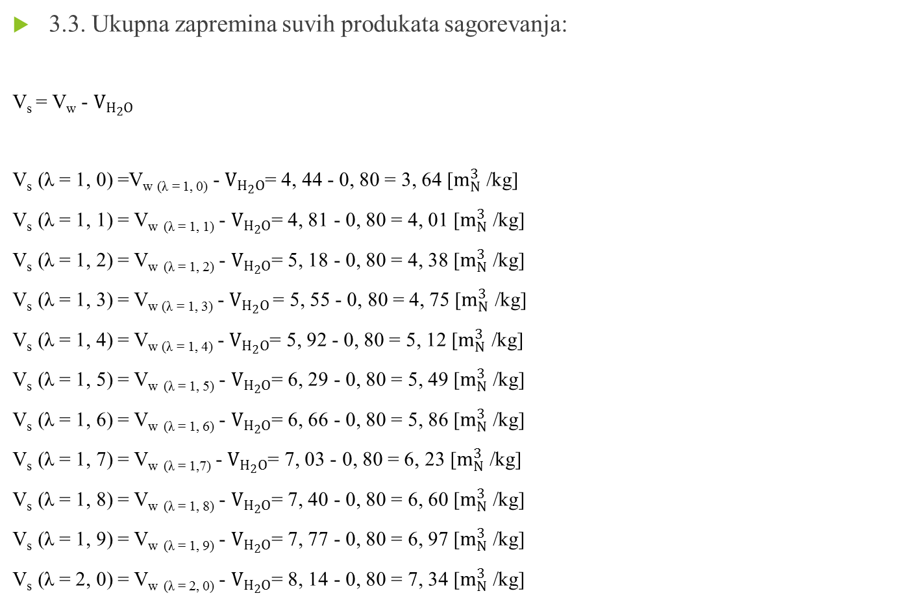
3.3. Ukupna zapremina suvih produkata sagorevanja:
V_{s} = V_{w} - $V_{H_{2}O}$
V_{s} (λ = 1, 0) =V_{w (λ = 1, 0)} - $V_{H_{2}O}$= 4, 44 - 0, 80 = 3, 64 [$m_{N}^{3}$ /kg]
V_{s} (λ = 1, 1) = V_{w} _{(λ = 1, 1)} - $V_{H_{2}O}$= 4, 81 - 0, 80 = 4, 01 [$m_{N}^{3}$ /kg]
V_{s} (λ = 1, 2) = V_{w} _{(λ = 1, 2)} - $V_{H_{2}O}$= 5, 18 - 0, 80 = 4, 38 [$m_{N}^{3}$ /kg]
V_{s} (λ = 1, 3) = V_{w (λ = 1, 3)} - $V_{H_{2}O}$ = 5, 55 - 0, 80 = 4, 75 [$m_{N}^{3}$ /kg]
V_{s} (λ = 1, 4) = V_{w (λ = 1, 4)} - $V_{H_{2}O}$= 5, 92 - 0, 80 = 5, 12 [$m_{N}^{3}$ /kg]
V_{s} (λ = 1, 5) = V_{w} _{(λ = 1, 5)} - $V_{H_{2}O}$= 6, 29 - 0, 80 = 5, 49 [$m_{N}^{3}$ /kg]
V_{s} (λ = 1, 6) = V_{w} _{(λ = 1, 6)} - $V_{H_{2}O}$= 6, 66 - 0, 80 = 5, 86 [$m_{N}^{3}$ /kg]
V_{s} (λ = 1, 7) = V_{w} _{(λ = 1,7)} - $V_{H_{2}O}$= 7, 03 - 0, 80 = 6, 23 [$m_{N}^{3}$ /kg]
V_{s} (λ = 1, 8) = V_{w} _{(λ = 1, 8)} - $V_{H_{2}O}$= 7, 40 - 0, 80 = 6, 60 [$m_{N}^{3}$ /kg]
V_{s} (λ = 1, 9) = V_{w} _{(λ = 1, 9)} - $V_{H_{2}O}$= 7, 77 - 0, 80 = 6, 97 [$m_{N}^{3}$ /kg]
V_{s} (λ = 2, 0) = V_{w} _{(λ = 2, 0)} - $V_{H_{2}O}$= 8, 14 - 0, 80 = 7, 34 [$m_{N}^{3}$ /kg]

Slide 8
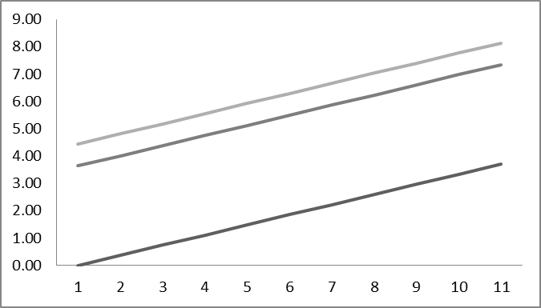
Dobijeni rezultati prikazuju se tabelarno i grafički:
Tabela 1.
λ | 1, 0 | 1, 1 | 1, 2 | 1, 3 | 1, 4 | 1, 5 | 1, 6 | 1, 7 | 1, 8 | 1, 9 | 2, 0
V_{l} | 0, 00 | 0, 37 | 0, 74 | 1, 11 | 1, 48 | 1, 85 | 2, 22 | 2, 59 | 2, 96 | 3, 33 | 3, 70
L | 3, 70 | 4, 07 | 4, 44 | 4, 81 | 5, 18 | 5, 55 | 5, 92 | 6, 29 | 6, 66 | 7, 03 | 7, 40
V_{w} | 4, 44 | 4, 81 | 5, 18 | 5, 55 | 5, 92 | 6, 29 | 6, 66 | 7, 03 | 7, 40 | 7, 77 | 8, 14
V_{s} | 3, 64 | 4, 01 | 4, 38 | 4, 75 | 5, 12 | 5, 49 | 5, 86 | 6, 23 | 6, 60 | 6, 97 | 7, 34
Slika 1. V_{x} – λ dijagram

Slide 9
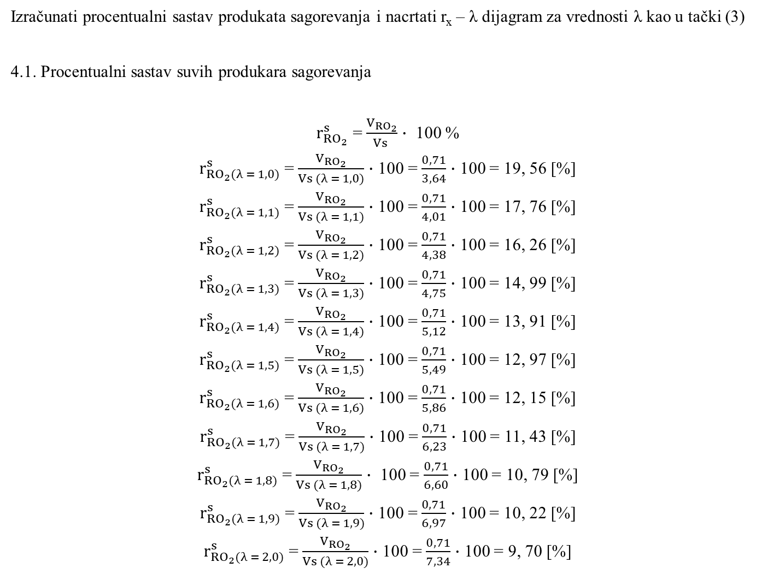
Izračunati procentualni sastav produkata sagorevanja i nacrtati r_{x} – λ dijagram za vrednosti λ kao u tački (3)
4.1. Procentualni sastav suvih produkara sagorevanja
$r_{{RO}_{2}}^{s}$ = $\frac{V_{{RO}_{2}}}{Vs }$ $∙$ 100 %
$r_{{RO}_{2}(λ = 1, 0)}^{s}$ = $\frac{V_{{RO}_{2}}}{Vs (λ = 1, 0)}$ $∙$ 100 = $\frac{0, 71}{3, 64}$ $∙$ 100 = 19, 56 [%]
$r_{{RO}_{2}(λ = 1, 1)}^{s}$ = $\frac{V_{{RO}_{2}}}{Vs (λ = 1, 1)}$ $∙$ 100 = $\frac{0, 71}{4, 01}$ $∙$ 100 = 17, 76 [%]
$r_{{RO}_{2}(λ = 1, 2)}^{s}$ = $\frac{V_{{RO}_{2}}}{Vs (λ = 1, 2)}$ $∙$ 100 = $\frac{0, 71}{4, 38}$ $∙$ 100 = 16, 26 [%]
$r_{{RO}_{2}(λ = 1, 3)}^{s}$ = $\frac{V_{{RO}_{2}}}{Vs (λ = 1, 3)}$ $∙$ 100 = $\frac{0, 71}{4, 75}$ $∙$ 100 = 14, 99 [%]
$r_{{RO}_{2}(λ = 1, 4)}^{s}$ = $\frac{V_{{RO}_{2}}}{Vs (λ = 1, 4)}$ $∙$ 100 = $\frac{0, 71}{5, 12}$ $∙$ 100 = 13, 91 [%]
$r_{{RO}_{2}(λ = 1, 5)}^{s}$ = $\frac{V_{{RO}_{2}}}{Vs (λ = 1, 5)}$ $∙$ 100 = $\frac{0, 71}{5, 49}$ $∙$ 100 = 12, 97 [%]
$r_{{RO}_{2}(λ = 1, 6)}^{s}$ = $\frac{V_{{RO}_{2}}}{Vs (λ = 1, 6)}$ $∙$ 100 = $\frac{0, 71}{5, 86}$ $∙$ 100 = 12, 15 [%]
$r_{{RO}_{2}(λ = 1, 7)}^{s}$ = $\frac{V_{{RO}_{2}}}{Vs (λ = 1, 7)}$ $∙$ 100 = $\frac{0, 71}{6, 23}$ $∙$ 100 = 11, 43 [%]
$r_{{RO}_{2}(λ = 1, 8)}^{s}$ = $\frac{V_{{RO}_{2}}}{Vs (λ = 1, 8)}$ $∙$ 100 = $\frac{0, 71}{6, 60}$ $∙$ 100 = 10, 79 [%]
$r_{{RO}_{2}(λ = 1, 9)}^{s}$ = $\frac{V_{{RO}_{2}}}{Vs (λ = 1, 9)}$ $∙$ 100 = $\frac{0, 71}{6, 97}$ $∙$ 100 = 10, 22 [%]
$r_{{RO}_{2}(λ = 2, 0)}^{s}$ = $\frac{V_{{RO}_{2}}}{Vs (λ = 2, 0)}$ $∙$ 100 = $\frac{0, 71}{7, 34}$ $∙$ 100 = 9, 70 [%]

Slide 10
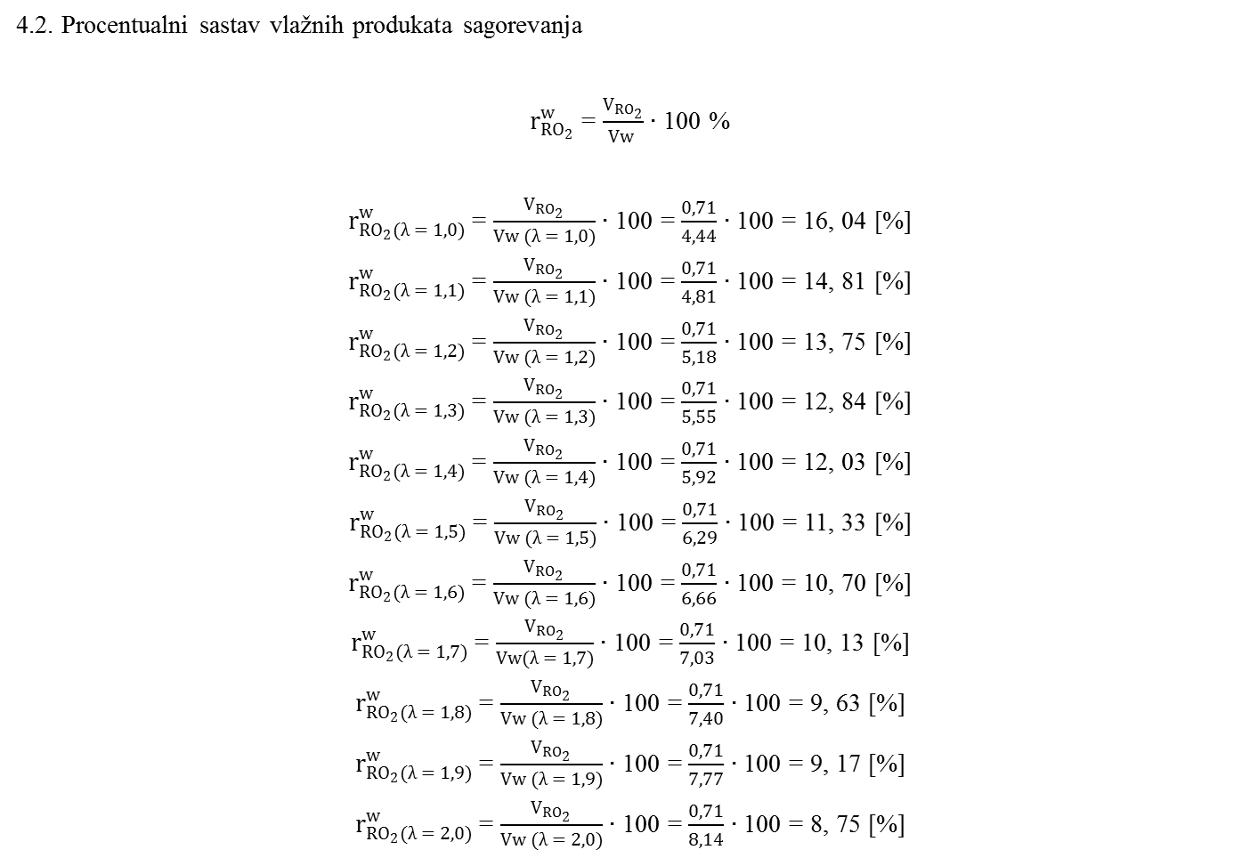
4.2. Procentualni sastav vlažnih produkata sagorevanja
$r_{{RO}_{2}}^{w}$ = $\frac{V_{{RO}_{2}}}{Vw }$ $∙$ 100 %
$r_{{RO}_{2}(λ = 1, 0)}^{w}$ = $\frac{V_{{RO}_{2}}}{Vw (λ = 1, 0)}$ $∙$ 100 = $\frac{0, 71}{4, 44}$ $∙$ 100 = 16, 04 [%]
$r_{{RO}_{2}(λ = 1, 1)}^{w}$ = $\frac{V_{{RO}_{2}}}{Vw (λ = 1, 1)}$ $∙$ 100 = $\frac{0, 71}{4, 81}$ $∙$ 100 = 14, 81 [%]
$r_{{RO}_{2}(λ = 1, 2)}^{w}$ = $\frac{V_{{RO}_{2}}}{Vw (λ = 1, 2)}$ $∙$ 100 = $\frac{0, 71}{5, 18}$ $∙$ 100 = 13, 75 [%]
$r_{{RO}_{2}(λ = 1, 3)}^{w}$ = $\frac{V_{{RO}_{2}}}{Vw (λ = 1, 3)}$ $∙$ 100 = $\frac{0, 71}{5, 55}$ $∙$ 100 = 12, 84 [%]
$r_{{RO}_{2}(λ = 1, 4)}^{w}$ = $\frac{V_{{RO}_{2}}}{Vw (λ = 1, 4)}$ $∙$ 100 = $\frac{0, 71}{5, 92}$ $∙$ 100 = 12, 03 [%]
$r_{{RO}_{2}(λ = 1, 5)}^{w}$ = $\frac{V_{{RO}_{2}}}{Vw (λ = 1, 5)}$ $∙$ 100 = $\frac{0, 71}{6, 29}$ $∙$ 100 = 11, 33 [%]
$r_{{RO}_{2}(λ = 1, 6)}^{w}$ = $\frac{V_{{RO}_{2}}}{Vw (λ = 1, 6)}$ $∙$ 100 = $\frac{0, 71}{6, 66}$ $∙$ 100 = 10, 70 [%]
$r_{{RO}_{2}(λ = 1, 7)}^{w}$ = $\frac{V_{{RO}_{2}}}{Vw(λ = 1, 7)}$ $∙$ 100 = $\frac{0, 71}{7, 03}$ $∙$ 100 = 10, 13 [%]
$r_{{RO}_{2}(λ = 1, 8)}^{w}$ = $\frac{V_{{RO}_{2}}}{Vw (λ = 1, 8)}$ $∙$ 100 = $\frac{0, 71}{7, 40}$ $∙$ 100 = 9, 63 [%]
$r_{{RO}_{2}(λ = 1, 9)}^{w}$ = $\frac{V_{{RO}_{2}}}{Vw (λ = 1, 9)}$ $∙$ 100 = $\frac{0, 71}{7, 77}$ $∙$ 100 = 9, 17 [%]
$r_{{RO}_{2}(λ = 2, 0)}^{w}$ = $\frac{V_{{RO}_{2}}}{Vw (λ = 2, 0)}$ $∙$ 100 = $\frac{0, 71}{8, 14}$ $∙$ 100 = 8, 75 [%]

Slide 11
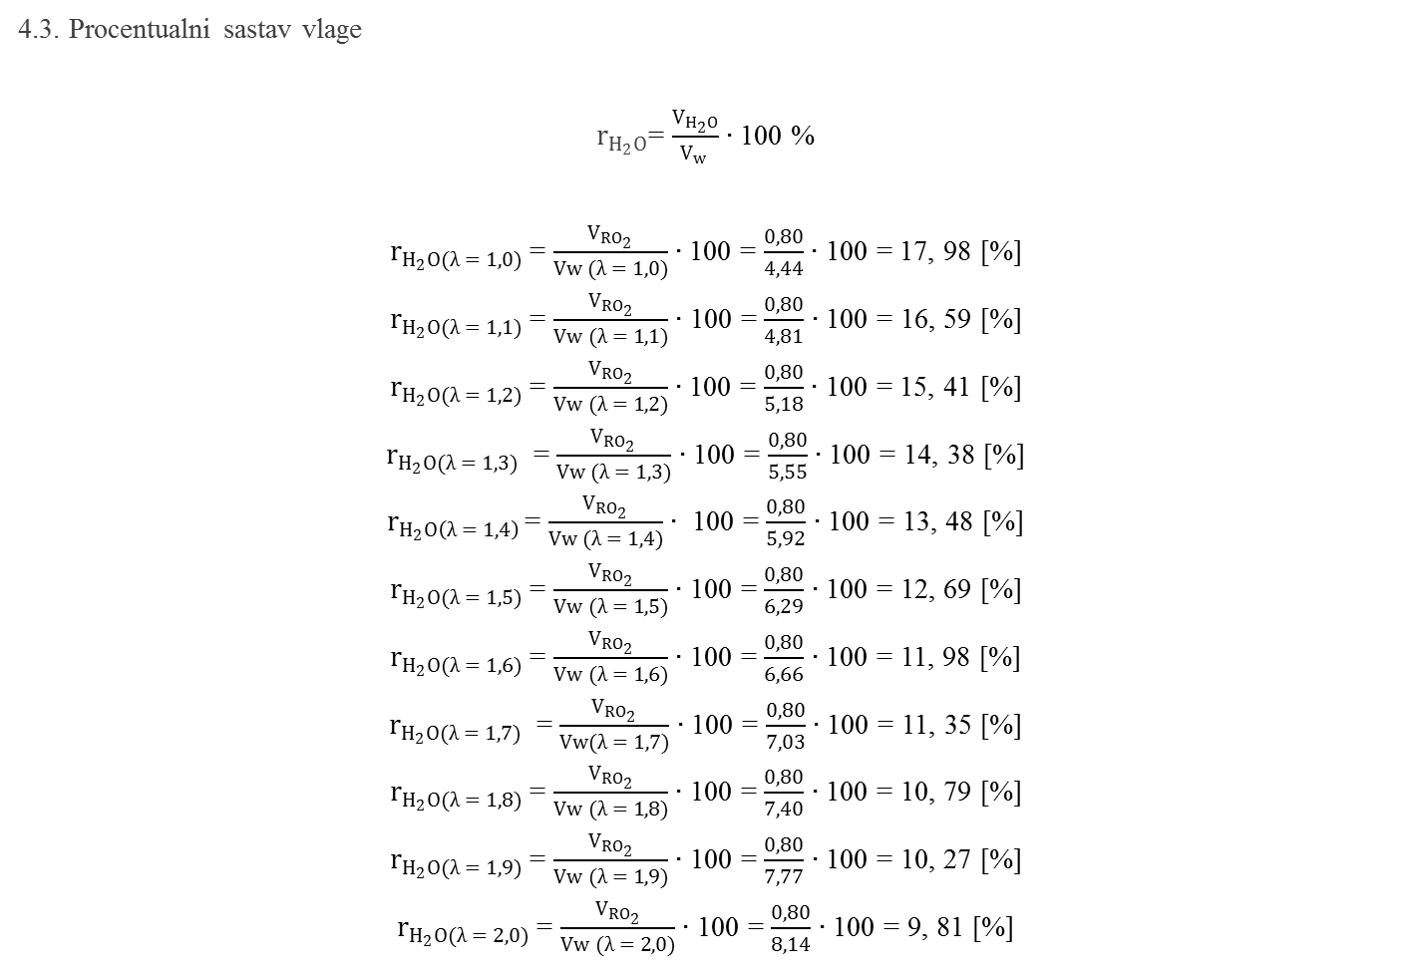
4.3. Procentualni sastav vlage
$r_{H_{2}O}$= $\frac{V_{H_{2}O}}{V_{w} }$ $∙$ 100 %
$r_{H_{2}O(λ = 1, 0)}$= $\frac{V_{{RO}_{2}}}{Vw (λ = 1, 0)}$ $∙$ 100 = $\frac{0,80}{4, 44}$ $∙$ 100 = 17, 98 [%]
$r_{H_{2}O(λ = 1, 1)}$ = $\frac{V_{{RO}_{2}}}{Vw (λ = 1, 1)}$ $∙$ 100 = $\frac{0, 80}{4, 81}$ $∙$ 100 = 16, 59 [%]
$r_{H_{2}O(λ = 1, 2)}$ = $\frac{V_{{RO}_{2}}}{Vw (λ = 1, 2)}∙$ 100 = $\frac{0, 80}{5, 18}$ $∙$ 100 = 15, 41 [%]
$r_{H_{2}O(λ = 1, 3)}$ = $\frac{V_{{RO}_{2}}}{Vw (λ = 1, 3)}$ $∙$ 100 = $\frac{0, 80}{5, 55}$ $∙$ 100 = 14, 38 [%]
$r_{H_{2}O\left(λ = 1, 4\right) }$= $\frac{V_{{RO}_{2}}}{Vw (λ = 1, 4)}$ $∙$ 100 = $\frac{0, 80}{5, 92}$ $∙$ 100 = 13, 48 [%]
$r_{H_{2}O(λ = 1, 5)}$ = $\frac{V_{{RO}_{2}}}{Vw (λ = 1, 5)}$ $∙$ 100 = $\frac{0, 80}{6, 29}$ $∙$ 100 = 12, 69 [%]
$r_{H_{2}O(λ = 1, 6)}$ = $\frac{V_{{RO}_{2}}}{Vw (λ = 1, 6)}$ $∙$ 100 = $\frac{0, 80}{6, 66}$ $∙$ 100 = 11, 98 [%]
$r_{H_{2}O(λ = 1, 7)}$ = $\frac{V_{{RO}_{2}}}{Vw(λ = 1, 7)}$ $∙$ 100 = $\frac{0, 80}{7, 03}$ $∙$ 100 = 11, 35 [%]
$r_{H_{2}O(λ = 1, 8)}$ = $\frac{V_{{RO}_{2}}}{Vw (λ = 1, 8)}$ $∙$ 100 = $\frac{0, 80}{7, 40}$ $∙$ 100 = 10, 79 [%]
$r_{H_{2}O(λ = 1, 9)}$ = $\frac{V_{{RO}_{2}}}{Vw (λ = 1, 9)}$ $∙$ 100 = $\frac{0, 80}{7, 77}$ $∙$ 100 = 10, 27 [%]
$r_{H_{2}O(λ = 2, 0)}$ = $\frac{V_{{RO}_{2}}}{Vw (λ = 2, 0)}$ $∙$ 100 = $\frac{0, 80}{8, 14}$ $∙$ 100 = 9, 81 [%]

Slide 12
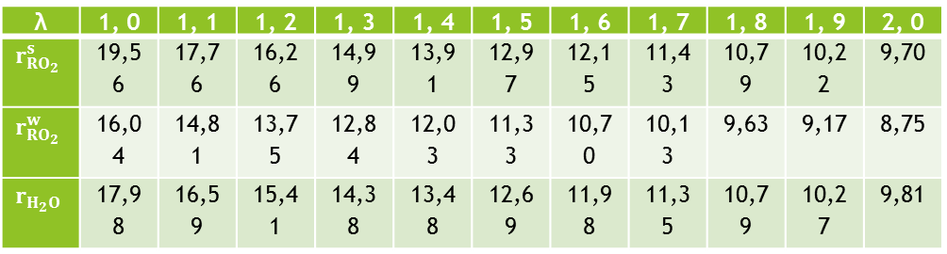
Sračunate vrednosti prikazuju se tabelarno i grafički
Tabela 2.
λ | 1, 0 | 1, 1 | 1, 2 | 1, 3 | 1, 4 | 1, 5 | 1, 6 | 1, 7 | 1, 8 | 1, 9 | 2, 0
$$r_{{RO}_{2}}^{s}$$ | 19,56 | 17,76 | 16,26 | 14,99 | 13,91 | 12,97 | 12,15 | 11,43 | 10,79 | 10,22 | 9,70
$$r_{{RO}_{2}}^{w}$$ | 16,04 | 14,81 | 13,75 | 12,84 | 12,03 | 11,33 | 10,70 | 10,13 | 9,63 | 9,17 | 8,75
$$r_{H_{2}O}$$ | 17,98 | 16,59 | 15,41 | 14,38 | 13,48 | 12,69 | 11,98 | 11,35 | 10,79 | 10,27 | 9,81
Slika 2. r- λ dijagram

Slide 13
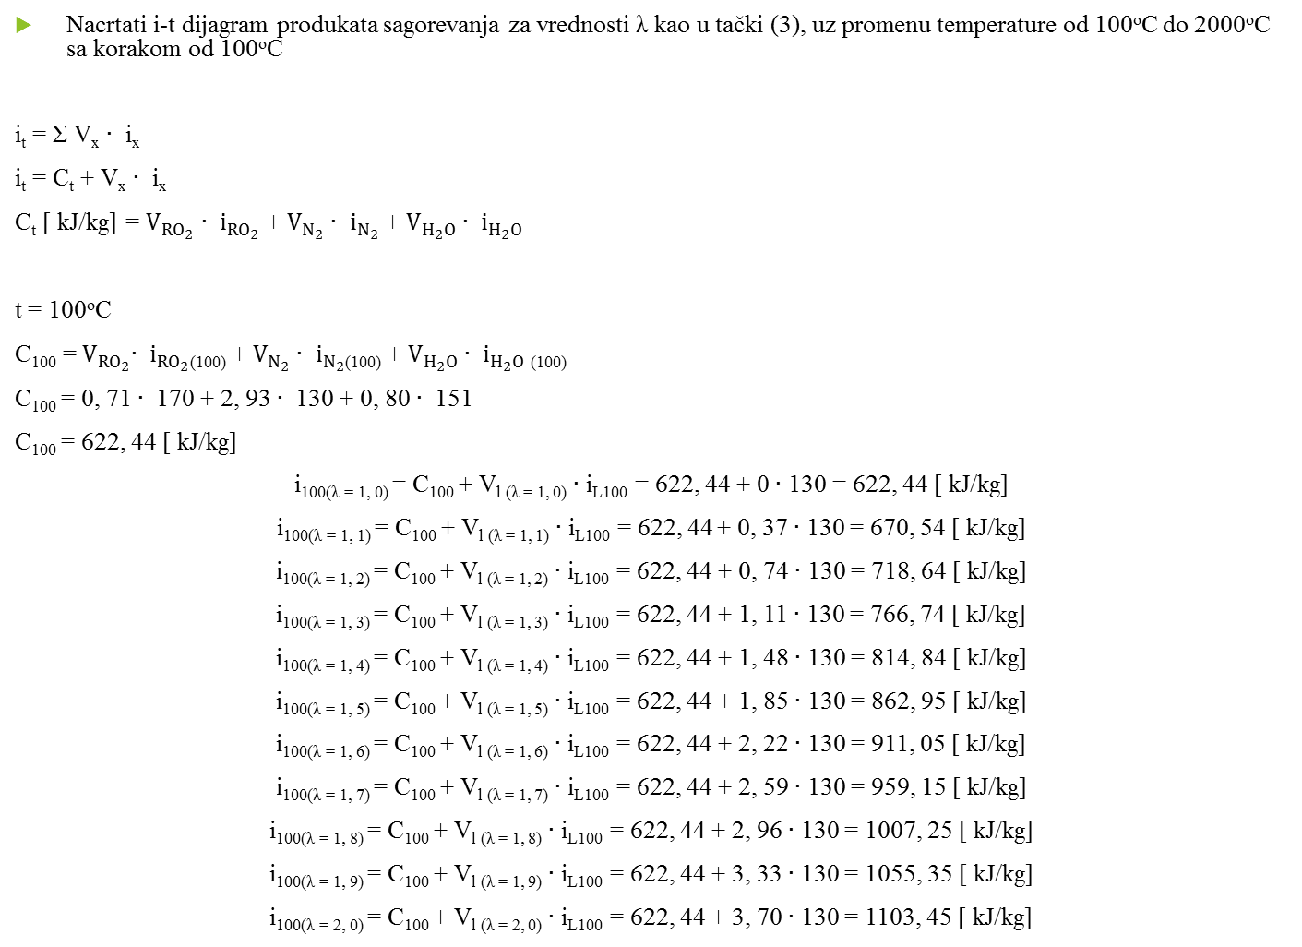
Nacrtati i-t dijagram produkata sagorevanja za vrednosti λ kao u tački (3), uz promenu temperature od 100ºC do 2000ºC sa korakom od 100ºC
i_{t} = Σ V_{x} $∙$ i_{x}
i_{t} = C_{t} + V_{x} $∙$ i_{x}
C_{t} [ kJ/kg] = $V_{{RO}_{2}}$ $∙$ $i_{{RO}_{2}}$ + $V_{N_{2}}∙$ $i_{N_{2}}$ + $V_{H_{2}O}$ $∙$ $i_{H_{2}O}$
t = 100ºC
C₁₀₀ =${ V}_{{RO}_{2}}∙$ $i_{{RO}_{2}}$₍₁₀₀₎ + $V_{N_{2}}∙$ $i_{N_{2}}$₍₁₀₀₎ + $V_{H_{2}O}$ $∙$ $i_{H_{2}O}$ ₍₁₀₀₎
C₁₀₀ = 0, 71 $∙$ 170 + 2, 93 $∙$ 130 + 0, 80 $∙$ 151
C₁₀₀ = 622, 44 [ kJ/kg]
i_{100(λ = 1, 0)} = C₁₀₀ + V_{l (λ = 1, 0)} $∙$ i_{L100} = 622, 44 + 0 $∙$ 130 = 622, 44 [ kJ/kg]
i_{100(λ = 1, 1)} = C₁₀₀ + V_{l (λ = 1, 1)} $∙$ i_{L100} = 622, 44 + 0, 37 $∙$ 130 = 670, 54 [ kJ/kg]
i_{100(λ = 1, 2)} = C₁₀₀ + V_{l (λ = 1, 2)} $∙$ i_{L100} = 622, 44 + 0, 74 $∙$ 130 = 718, 64 [ kJ/kg]
i_{100(λ = 1, 3)} = C₁₀₀ + V_{l (λ = 1, 3)} $∙$ i_{L100} = 622, 44 + 1, 11 $∙$ 130 = 766, 74 [ kJ/kg]
i_{100(λ = 1, 4)} = C₁₀₀ + V_{l (λ = 1, 4)} $∙$ i_{L100} = 622, 44 + 1, 48 $∙$ 130 = 814, 84 [ kJ/kg]
i_{100(λ = 1, 5)} = C₁₀₀ + V_{l (λ = 1, 5)} $∙$ i_{L100} = 622, 44 + 1, 85 $∙$ 130 = 862, 95 [ kJ/kg]
i_{100(λ = 1, 6)} = C₁₀₀ + V_{l (λ = 1, 6)} $∙$ i_{L100} = 622, 44 + 2, 22 $∙$ 130 = 911, 05 [ kJ/kg]
i_{100(λ = 1, 7)} = C₁₀₀ + V_{l (λ = 1, 7)} $∙$ i_{L100} = 622, 44 + 2, 59 $∙$ 130 = 959, 15 [ kJ/kg]
i_{100(λ = 1, 8)} = C₁₀₀ + V_{l (λ = 1, 8)} $∙$ i_{L100} = 622, 44 + 2, 96 $∙$ 130 = 1007, 25 [ kJ/kg]
i_{100(λ = 1, 9)} = C₁₀₀ + V_{l (λ = 1, 9)} $∙$ i_{L100} = 622, 44 + 3, 33 $∙$ 130 = 1055, 35 [ kJ/kg]
i_{100(λ = 2, 0)} = C₁₀₀ + V_{l (λ = 2, 0)} $∙$ i_{L100} = 622, 44 + 3, 70 $∙$ 130 = 1103, 45 [ kJ/kg]

Slide 14
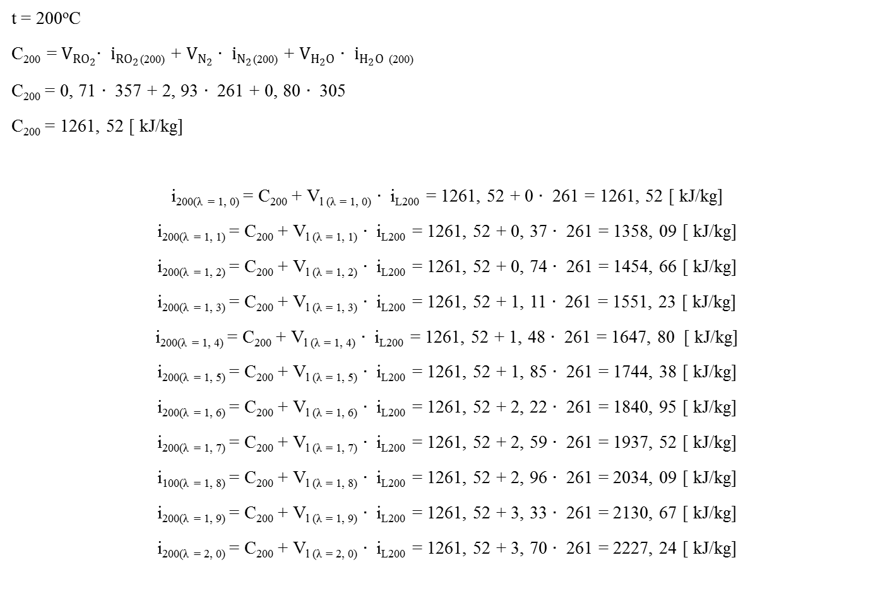
t = 200ºC
C₂₀₀ =${ V}_{{RO}_{2}}∙$ $i_{{RO}_{2}}$₍₂₀₀₎ + $V_{N_{2}}∙$ $i_{N_{2}}$₍₂₀₀₎ + $V_{H_{2}O}$ $∙$ $i_{H_{2}O}$ ₍₂₀₀₎
C₂₀₀ = 0, 71 $∙$ 357 + 2, 93 $∙$ 261 + 0, 80 $∙$ 305
C₂₀₀ = 1261, 52 [ kJ/kg]
i_{200(λ = 1, 0)} = C₂₀₀ + V_{l (λ = 1, 0)} $∙$ i_{L200} = 1261, 52 + 0 $∙$ 261 = 1261, 52 [ kJ/kg]
i_{200(λ = 1, 1)} = C₂₀₀ + V_{l (λ = 1, 1)} $∙$ i_{L200} = 1261, 52 + 0, 37 $∙$ 261 = 1358, 09 [ kJ/kg]
i_{200(λ = 1, 2)} = C₂₀₀ + V_{l (λ = 1, 2)} $∙$ i_{L200} = 1261, 52 + 0, 74 $∙$ 261 = 1454, 66 [ kJ/kg]
i_{200(λ = 1, 3)} = C₂₀₀ + V_{l (λ = 1, 3)} $∙$ i_{L200} = 1261, 52 + 1, 11 $∙$ 261 = 1551, 23 [ kJ/kg]
i_{200(λ = 1, 4)} = C₂₀₀ + V_{l (λ = 1, 4)} $∙$ i_{L200} = 1261, 52 + 1, 48 $∙$ 261 = 1647, 80 [ kJ/kg]
i_{200(λ = 1, 5)} = C₂₀₀ + V_{l (λ = 1, 5)} $∙$ i_{L200} = 1261, 52 + 1, 85 $∙$ 261 = 1744, 38 [ kJ/kg]
i_{200(λ = 1, 6)} = C₂₀₀ + V_{l (λ = 1, 6)} $∙$ i_{L200} = 1261, 52 + 2, 22 $∙$ 261 = 1840, 95 [ kJ/kg]
i_{200(λ = 1, 7)} = C₂₀₀ + V_{l (λ = 1, 7)} $∙$ i_{L200} = 1261, 52 + 2, 59 $∙$ 261 = 1937, 52 [ kJ/kg]
i_{100(λ = 1, 8)} = C₂₀₀ + V_{l (λ = 1, 8)} $∙$ i_{L200} = 1261, 52 + 2, 96 $∙$ 261 = 2034, 09 [ kJ/kg]
i_{200(λ = 1, 9)} = C₂₀₀ + V_{l (λ = 1, 9)} $∙$ i_{L200} = 1261, 52 + 3, 33 $∙$ 261 = 2130, 67 [ kJ/kg]
i_{200(λ = 2, 0)} = C₂₀₀ + V_{l (λ = 2, 0)} $∙$ i_{L200} = 1261, 52 + 3, 70 $∙$ 261 = 2227, 24 [ kJ/kg]

Slide 15
Sračunate vrednosti entalpija u zavisnosti od koeficijenta viška vazduha i temperature prikazane su tabelarno i grafički:
λ | 1, 0 | 1, 1 | 1, 2 | 1, 3 | 1, 4 | 1, 5 | 1, 6 | 1, 7 | 1, 8 | 1, 9 | 2, 0
t(ºC)
100 | 622,44 | 670,54 | 718,64 | 766,74 | 814,84 | 862,95 | 911,05 | 959,15 | 1007,25 | 1055,35 | 1103,45
200 | 1261,52 | 1358,09 | 1454,66 | 1551,23 | 1647,80 | 1744,38 | 1840,95 | 1937,52 | 2034,09 | 2130,67 | 2227,24
300 | 1918,99 | 2065,15 | 2211,30 | 2357,45 | 2503,61 | 2649,76 | 2795,91 | 2942,07 | 3088,22 | 3234,37 | 3380,53
400 | 2596,29 | 2793,13 | 2989,98 | 3186,82 | 3383,67 | 3580,51 | 3777,36 | 3974,20 | 4171,05 | 4367,89 | 4564,74
500 | 3437,24 | 3685,89 | 3934,53 | 4183,18 | 4431,83 | 4680,47 | 4929,12 | 5177,76 | 5426,41 | 5675,05 | 5923,70
600 | 4010,05 | 4311,23 | 4612,42 | 4913,61 | 5214,79 | 5515,98 | 5817,17 | 6118,36 | 6419,54 | 6720,73 | 7021,92
700 | 4744,37 | 5099,58 | 5454,79 | 5810,00 | 6165,20 | 6520,41 | 6875,62 | 7230,83 | 7586,04 | 7941,25 | 8296,45
800 | 5492,82 | 5902,42 | 6312,02 | 6721,62 | 7131,22 | 7540,82 | 7950,42 | 8360,02 | 8769,62 | 9179,22 | 9588,81
900 | 6258,49 | 6723,96 | 7189,43 | 7654,91 | 8120,38 | 8585,85 | 9051,32 | 9516,79 | 9982,26 | 10447,73 | 10913,20
100 | 7037,58 | 7559,29 | 8081,00 | 8602,71 | 9124,43 | 9646,14 | 10167,85 | 10689,56 | 11211,27 | 11732,99 | 12254,70
110 | 7827,94 | 8406,63 | 8985,32 | 9564,02 | 10142,71 | 10721,40 | 11300,10 | 11878,79 | 12457,48 | 13036,18 | 13614,87
1200 | 8628,06 | 9264,11 | 9900,15 | 10536,20 | 11172,24 | 11808,29 | 12444,33 | 13080,38 | 13716,42 | 14352,47 | 14988,51
1300 | 9440,18 | 10134,31 | 10828,45 | 11522,59 | 12216,72 | 12910,86 | 13604,99 | 14299,13 | 14993,27 | 15687,40 | 16381,54
1400 | 10258,33 | 11010,93 | 11763,52 | 12516,12 | 13268,72 | 14021,32 | 14773,91 | 15526,51 | 16279,11 | 17031,71 | 17784,30
1500
1600 | 11918,07 | 12788,70 | 13659,33 | 14529,96 | 15400,59 | 16271,22 | 17141,85 | 18012,48 | 18883,11 | 19753,74 | 20624,37
1700
1800 | 13601,33 | 14591,48 | 15581,62 | 16571,76 | 17561,90 | 18552,05 | 19542,19 | 20532,33 | 21522,48 | 22512,62 | 23502,76
1900
2000 | 15307,06 | 16417,83 | 17528,59 | 18639,36 | 19750,12 | 20860.89 | 21971,65 | 23082,42 | 24193,19 | 25303,95 | 26414,72

